Slide 2
Students will be able to:
Today we are learning about Homeostasis.
Describe homeostasis and negative feedback.
Know the key features of a feedback loop.

Slide 3
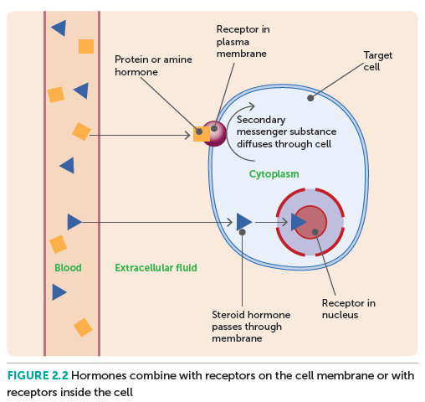
Review: Endocrine System
Glands are the fundamental organs that make up the endocrine system.
These organs are made up of specialised cells that produce and secrete hormones, which regulate and control the behaviour of cells.
The cells making up the glands secrete hormone molecules into the extracellular fluid, where they can then diffuse into the capillaries, and travel around the body to target cells/organs via the circulatory system.
Notes:
Teacher Cue – refer to the vocabulary box as you read through and “unpack” the definition provided. Use hand gestures to emphasise the ”2 or more”, “mixed” and “separated” parts of the definition.
Have students complete CFU 1 as a pair-share, then record these definitions & examples as notes (with diagrams) if desired.
CFU 2 – pair-share, then whiteboards for answers – call on non-volunteers.

Slide 4
Hormones
Certain hormones only affect certain cells, called target cells, which possess receptors that are complementary with the hormone molecules.
That is, hormones are specific in the cells they affect. These hormone receptor sites can become saturated, and as such, when all available receptor sites are occupied by a hormone molecule, no further binding is possible and any excess hormone molecules produce no change in cellular function.
Notes:
CFU – read through the slide, have students look closely at the diagram, then allow think time, before asking them to explain it to their partner using the key terms pure substance and mixture. Call on non-volunteers and provide feedback, encouraging detailed responses in full sentence form.

Slide 5
Hormones
Hormones can be classified by the ways in which they interact with cells:
Steroid hormones: also known as lipid-soluble hormones, are able to diffuse through the lipid portion of the phospholipid bilayer making up the cell membrane and enter the cytosol. From here, they can bind to a receptor in the nucleus or a receptor associated with the mitochondria, and the formation of this hormone-receptor complex causes a change in gene transcription and translation.
Protein and Amine hormones: also known as water-soluble hormones, are unable to pass through the bilayer into the cell. Hence, they form a hormone-receptor complex with a receptor located on the surface of the cell membrane. This causes the formation of a secondary messenger substance that diffuses through the cell and activates particular enzymes and proteins, thus changing cell metabolism.

Slide 6
Hormones
Hormones change the functioning of the cell by altering the behaviour and production of proteins. This is done by:
Initiating the transcription of a particular gene to produce a protein.
2. Changing the rate at which transcription occurs to produce a greater or smaller amount of a protein.
3. Activating or deactivating proteins and enzymes.
After a hormone has produced its desired effect, it must be broken down and excreted. Often, the break down occurs in the kidneys or the liver, but can also occur in the target cell itself. From there, the degraded material is excreted from the body as a component of urine or bile.

Slide 7
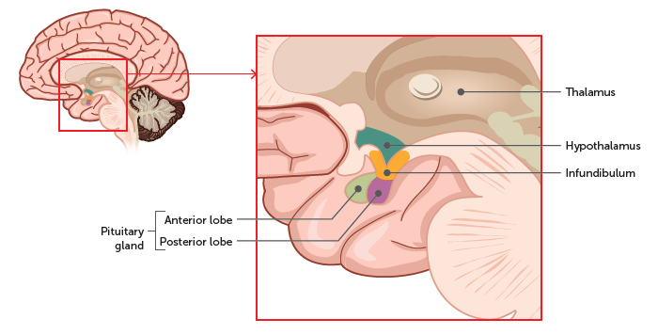
Hormones
To prevent unnecessary consumption of energy and materials in the body, the production and secretion of hormones is closely regulated by a process called negative feedback, whereby the presence of a particular hormone in the body is detected and certain mechanisms prevent the release of more hormone molecules.
This process involves two components of the nervous system called the hypothalamus and the pituitary gland.
Notes:
CFU – read through the slide, have students look closely at the diagram, then allow think time, before asking them to explain it to their partner using the key terms pure substance and mixture. Call on non-volunteers and provide feedback, encouraging detailed responses in full sentence form.

Slide 8
Homeostasis and its mechanisms
Homeostasis is the process by which the body maintains its environment. A relatively constant environment is necessary for optimal body functionality, as most components of the body become dysfunctional outside certain tolerance limits.
This doesn't mean that the conditions of the body never change - rather, that they fluctuate in a dynamic equilibrium (or steady state) around a set point at which systems work at their best. For the body to maintain these conditions, it needs to be able to detect changes and counteract them. In this way, it is the joint efforts of the nervous and endocrine systems that allow the body to function seamlessly.

Slide 9
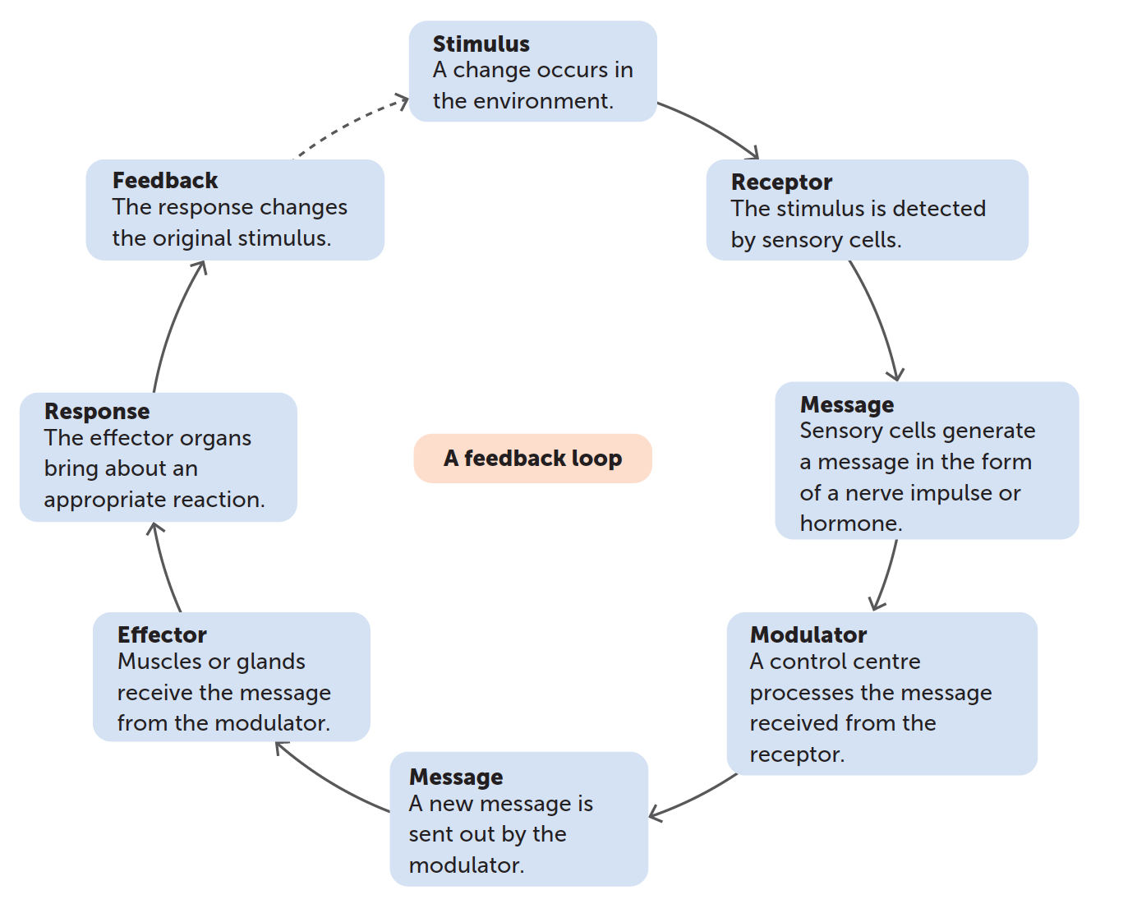
Homeostasis and its mechanisms
The main mechanisms through which homeostasis operates are feedback systems, through which the response to a stimulus changes the stimulus itself.
Negative feedback: the response reduces or eradicates the stimulus
Positive feedback: the response intensifies the stimulus
As positive feedback is not involved in homeostasis, we will focus on negative feedback mechanisms first.

Slide 10
Homeostasis and its mechanisms
All feedback mechanisms consist of the following key features:
Stimulus
Receptor
Modulator
Effector
Feedback

